Slide 1


SMART INDIA HACKATHON 2025
Problem Statement ID – 25019
Problem Statement Title- Digital Learning Platform for Rural School Students in Nabha
Theme- Smart Education
PS Category- Software/Hardware
Team ID-
Team Name (Registered on portal) - Cloudineers

Slide 2
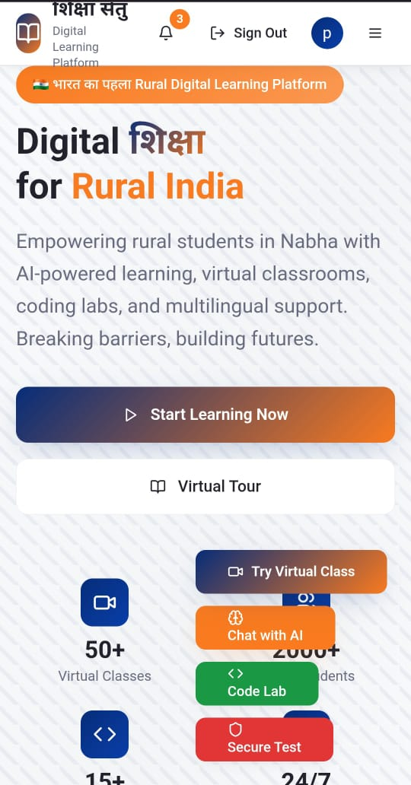
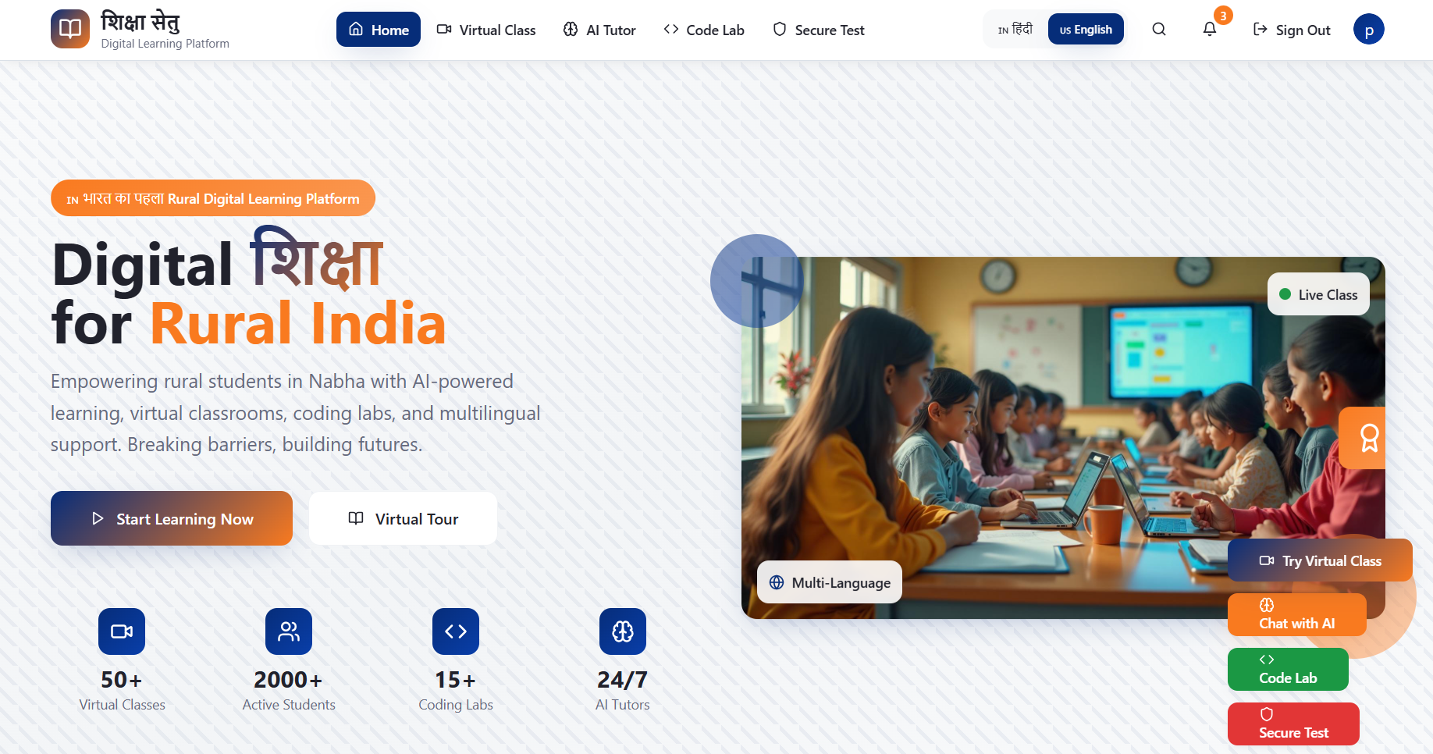
A Resilient Digital Learning Platform
Cloudineers
Proposed Solution:
Bridging the Rural Education GapChallenges:
Poor Infrastructure: Limited internet & computers in Nabha schools.
Digital Disparity: Low digital literacy, restricted access to quality content.
Widening Divide: Rural students lag behind urban peers.
Our Solution:
Resilient Digital Platform – Mobile + web-based, works on low-end devices.
Offline-First Design – Seamless learning with limited connectivity.
AI Tutoring – Personalized support & feedback for every student.

Slide 3
TECHNICAL APPROACH
Cloudineers
Technologies to be used –
Frontend: React Native(mobile) and React.js(web)
Backend: Node.js and Django
Database: Firebase
Key APIs: OpenAI/Gemini for AI, OpenCV for engagement detection, and Judge for coding compilation.
Methodology and process for implementation- The platform is built on a modern, scalable technology stack for performance and reliability in challenging environments.
Interactive learning is fostered through virtual whiteboards and collaborative peer spaces
Secure online tests are conducted using camera-based proctoring and real-time tab-change monitoring

Slide 4
FEASIBILITY AND VIABILITY
Cloudineers
Analysis of the feasibility of the idea - The platform is universally accessible, functioning on low-end mobile devices common in rural areas. The offline-first architecture makes it viable in areas with limited internet access.
Potential challenges and risks - Limited digital infrastructure in many rural government schools, including unreliable internet and insufficient computers. The existing educational gap between rural and urban students.
Strategies for overcoming these challenges –
The offline-first design addresses unreliable internet connectivity.
AI-powered features and multi-language support aim to break down language barriers and provide personalized learning.
The platform provides a comprehensive documentation hub and integrated online compilers to develop digital literacy skills.

Slide 5
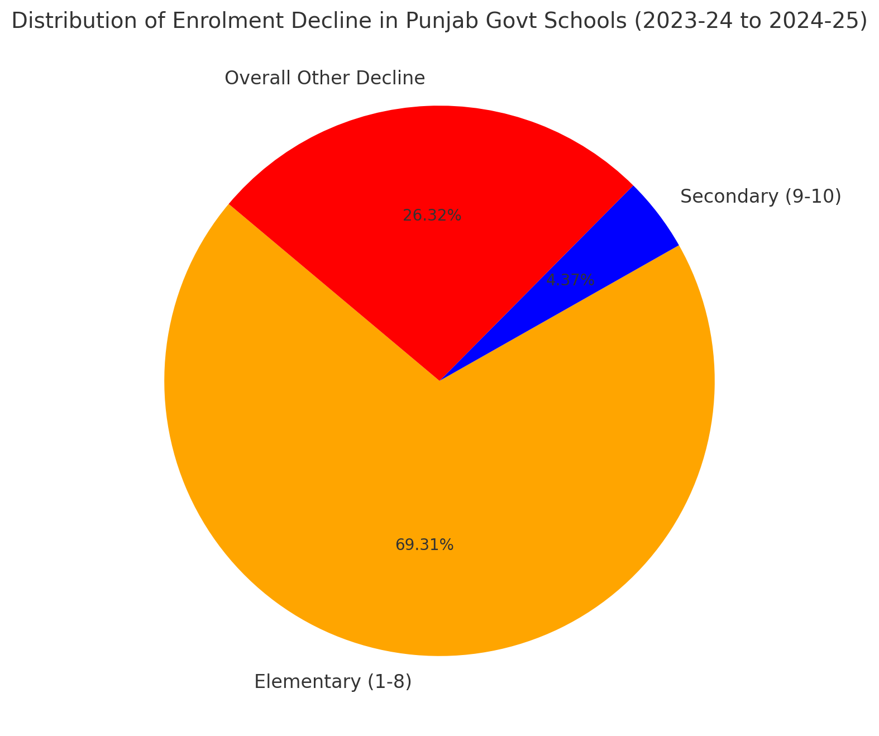
IMPACT AND BENEFITS
Cloudineers
Potential impact on the target audience –
The platform aims to empower rural school students in Nabha
It equips them with essential future-ready skills, preparing them for the digital economy
Benefits of the solution –
Social - Promotes digital literacy and ensures inclusive learning by making quality education accessible to every student, regardless of their background
Economic - Prepares students for the digital economy.
Environmental - Empowers educators with smart tools and real-time analytics on student progress, attendance, and engagement, enabling data-driven instruction. It also includes automated grading to reduce manual effort for teachers

Slide 6
RESEARCH AND REFERENCES
Cloudineers
Details / Links of the reference and research work –
This project addresses the critical challenge of the rural education gap in India, which is characterized by limited infrastructure and educational disparity
The solution is based on the need to bridge the divide between rural and urban students.
Research Work:
Hindustan Times: School enrolments in Punjab’s govt schools drop by 1.5 lakh
Data.gov.in: District-wise Dropout Ratio in Schools of Punjab
Website Link: शिक्षा सेतु - Digital Learning Platform for Rural India

